Slide 1


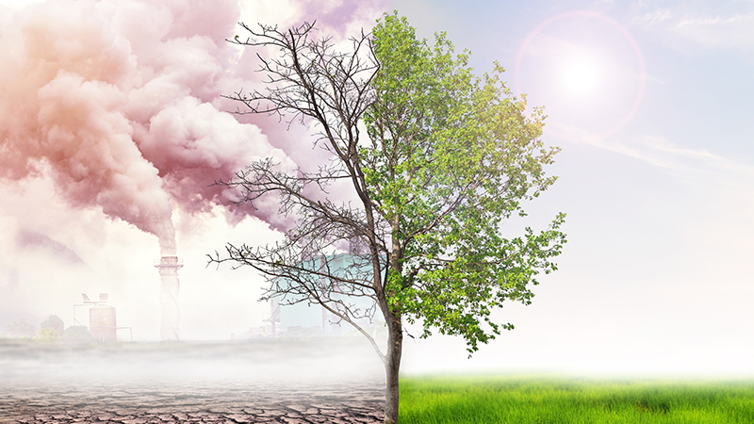
Global Climate change
Team members:
Hetal Prajapati, Hawa Abdo, Robert Morris and Casey Wright

Slide 2
Introduction
The goal of this project is to provide a comprehensive data visualization of global climate change and its overall impact. To conduct this analysis, we first gathered data from the International Monetary Fund and the World Health Organization, compiling a dataset that includes temperature changes, CO₂ emissions, sea level variations, climate-related disasters, and pollution-related illnesses.
Questions we explored:
How has climate changed over time?
What are the impacts of climate change?

Slide 3
Website overview
After assembling our datasets, we utilized JavaScript to develop interactive visualizations that illustrate trends in global climate change over time. This site showcases these visualizations, along with detailed explanations and insights into significant patterns and trends observed in the data.

Slide 4
navigating website
Starts with our homepage, with a dropdown menu that includes the menu, the visualization and a list of each of the visualizations we have available
Within each visualization, you can select a different visualization or you can select the home button to bring it back to the homepage
Visualizations included:
Temperature Change
CO2 Emission
Sea Level Change
Climate Related Disasters
Illness Related to Pollution

Slide 5
Cleaned data
We created a PostgreSQL database and stored our data in their relative tables we used SQL to clean our data and exported the cleaned data to csv files and used it for our visualizations
Our data is expressed through annual surface temperature change, change in mean sea levels, climate related disasters frequency, CO2 emissions, and illness related to pollution

Slide 6
Ethical considerations
For our project, we only used open sourced publicly available data sets from reputable organizations to compile data for our project. Facts are not considered original and therefore may not be copyrighted. We also did not use any personal identifying information for our project. The data is broad in scope and represents the full population and does not specify racial backgrounds
Exploring the link between the frequency of natural disasters, rising sea levels, rising temperatures with climate change and how it affects the population
These indicators focus on examining the correlation between carbon dioxide atmospheric concentrations and trends in global warming
Findings are documented annually

Slide 7
Data set references:
https://climatedata.imf.org/pages/climatechange-data
https://www.who.int/data/gho/data/themes/air-pollution/total-burden-of-disease-from-household-and-ambient-air-pollution
https://www.star.nesdis.noaa.gov/socd/lsa/SeaLevelRise/LSA_SLR_timeseries.php
https://opencagedata.com/
https://www.fao.org/faostat/en/#data/ET
https://www.oecd.org/sti/ind/carbondioxideemissionsembodiedininternationaltrade.htm

